Slide 1
NBA Player Stats Data Analysis
TTP 289 Project
Ye Chao

Slide 2
About the Dataset
The dataset contains aggregate individual statistics for 67 NBA seasons including basic box-score attributes such as points, assists, rebounds etc. With over 24k rows, the dataset has 53 variables, listed as follow:
Year: Season
Player: name
Pos: Position
Age: Age
Tm: Team
G: Games
GS: Games Started
MP: Minutes Played
PER: Player Efficiency Rating
TS%: True Shooting %
3Par: 3-Point Attempt Rate
FTr: Free Throw Rate
ORB%: Offensive Rebound Percentage
DRB%: Defensive Rebound Percentage
TRB%: Total Rebound Percentage
AST%: Assist Percentage
STL%: Steal Percentage
BLK%: Block Percentage
TOV%: Turnover Percentage
USG%: Usage Percentage
OWS: Offensive Win Shares
DWS: Defensive Win Shares
WS: Win Shares
WS/48: Win Shares Per 48 Minutes
OBPM: Offensive Box Plus/Minus
DBPM: Defensive Box Plus/Minus
BPMBox: Plus/Minus
VORPValue Over Replacement
FG: Field Goals
FGA: Field Goal Attempts
3P: 3-Point Field Goals
3PA: 3-Point Field Goal Attempts
3P%: 3-Point Field Goal Percentage
2P: 2-Point Field Goals
2PA: 2-Point Field Goal Attempts
2P%: 2-Point Field Goal Percentage
FT: Free Throws
FTA: Free Throw Attempts
FT%: Free Throw Percentage
ORB: Offensive Rebounds
DRB: Defensive Rebounds
TRB: Total Rebounds
AST: Assists
STL: Steals
BLK: Blocks
TOV: Turnovers
PF: Personal Fouls
PTS: Points
Notes:
Season performance since 1960, but for complete dataset, use after 1980.

Slide 3
What I did
Did a basic analysis of the data
Brought in players' salary data and did some regression
Prediction model on players that could go into the NBA Hall of Fame
Notes:
First tried the regression on win share, which measures a players contribution of winning a game, but the data was actually calculated by the other variables.

Slide 4
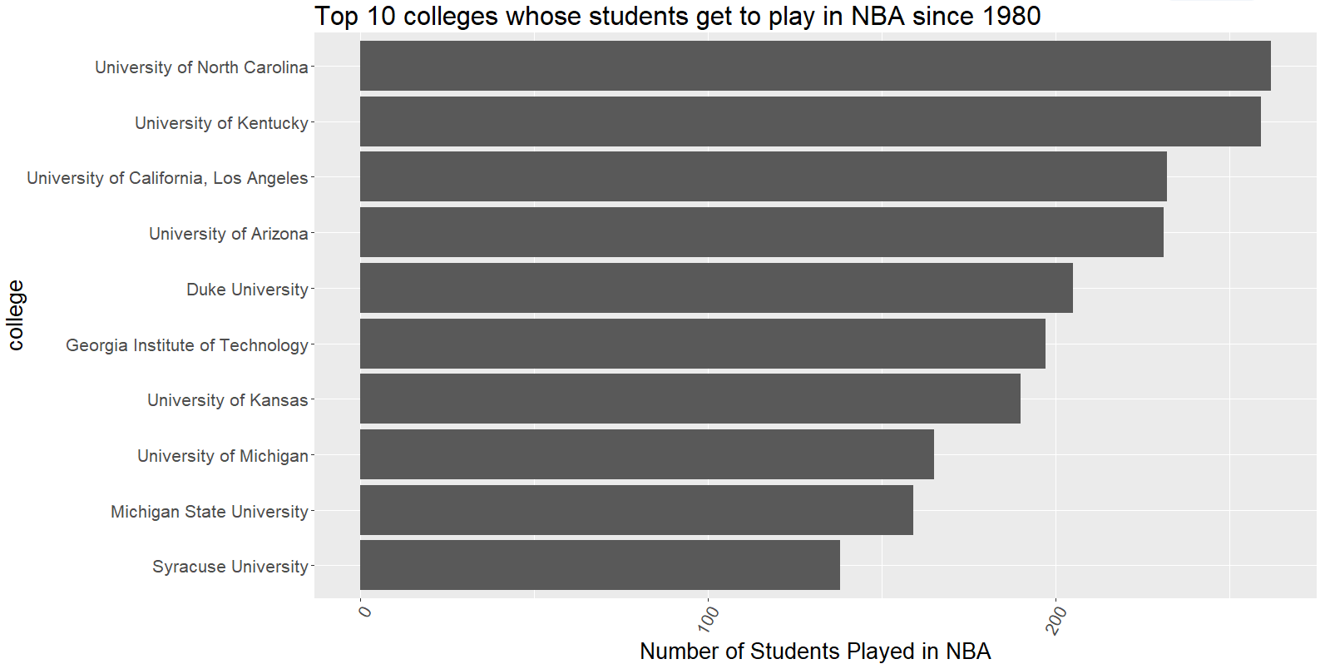
Basic Analysis – Where they started
Notes:
Some NCAA traditional strong team came up

Slide 5
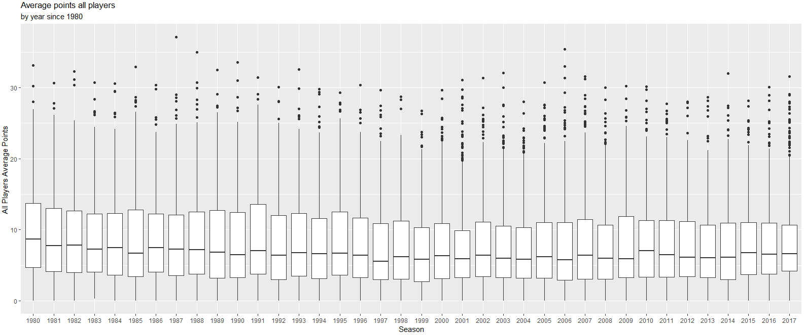
Basic Analysis – Average Points over the years
Notes:
Focus on all players average points over the year. Though some small flucation, but basically remains the same. The highest point being 1987 Michael Jordan.

Slide 6
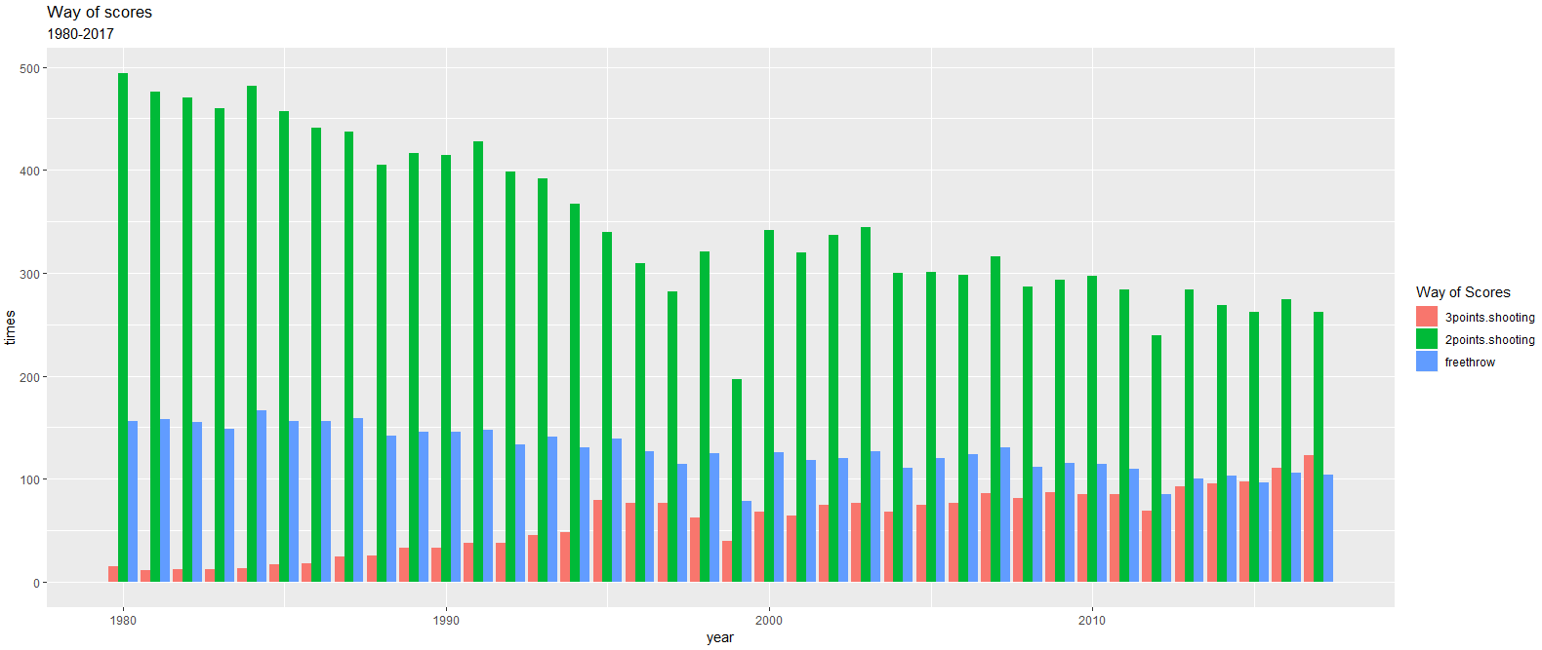
Basic Analysis – How they score
Notes:
2 points shooting decreasing, 3 points shooting increasing, free throw basically remains the same.

Slide 7
Salary Regression on players season performance
The use of ‘real.salary’, an annual 2% monetary inflation rate is introduced.
Simple linear model, Ridge model, Lasso model, PCA model, and KNN model are considered and being compared.

Slide 8
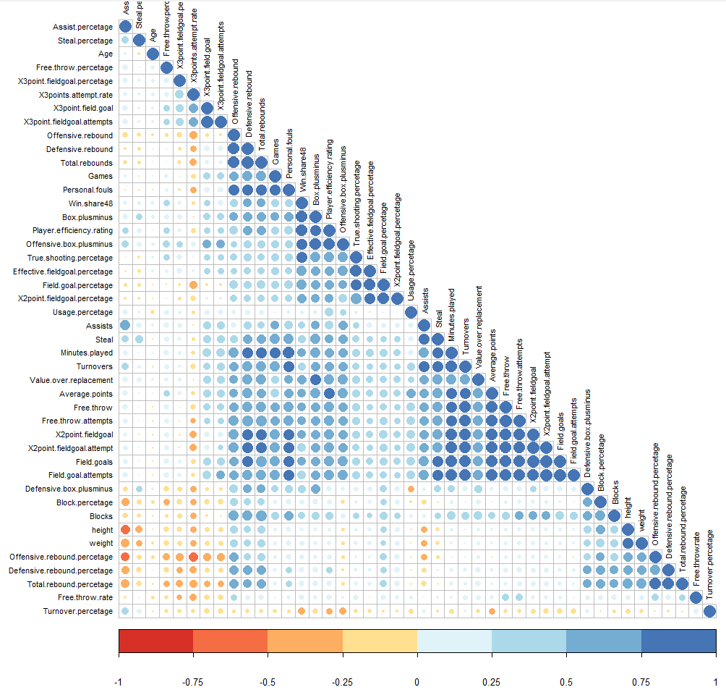
Salary Regression – Variables Selection
(1) Based on the correlation plot, selected some variables that have low correlation
(2) StepAIC(model, direction= “backward”)
(3) 8 variables were selected
lm(formula = real.salary ~ Age + Total.rebound.percetage +
Assist.percetage + Steal.percetage + Field.goal.percetage + Free.throw.percetage + height + Average.points,
data = Season_salary)

Slide 9
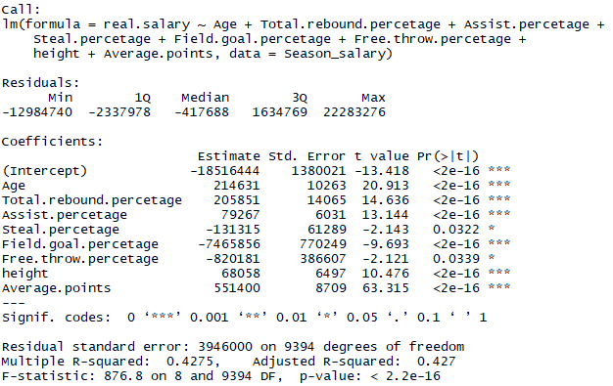
Salary Regression – 8 variables Linear model
Notes:
Reasonable to reject the linear hypothesis. Wonder if Multiple collinearity exists.

Slide 10
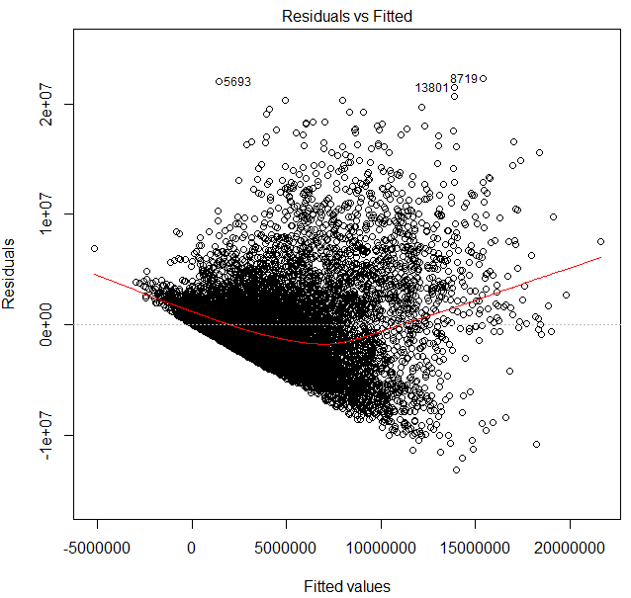
Salary Regression – 8 variables Linear model
Notes:
Reasonable to reject the linear hypothesis. Wonder if Multiple collinearity exists.

Slide 11
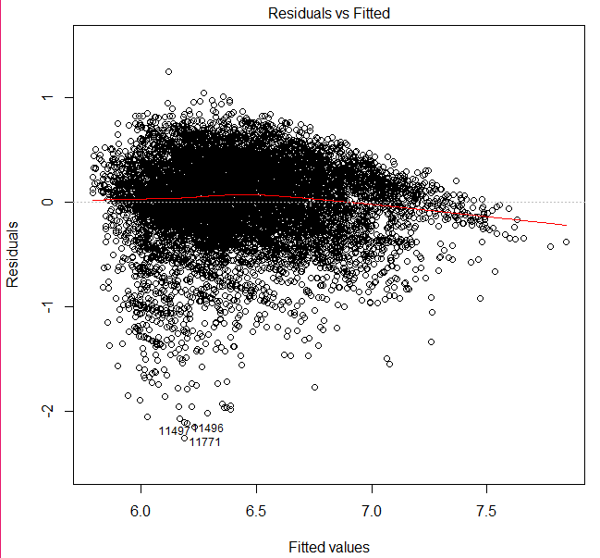
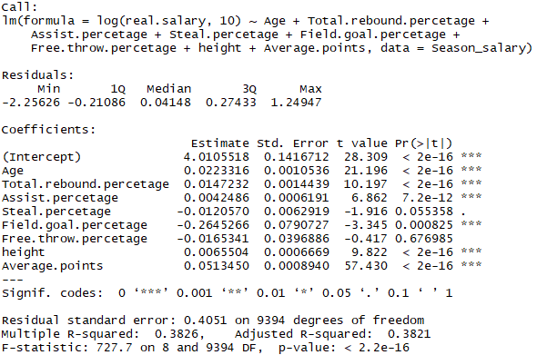
Salary Regression – 8 variables lg Linear model

Slide 12
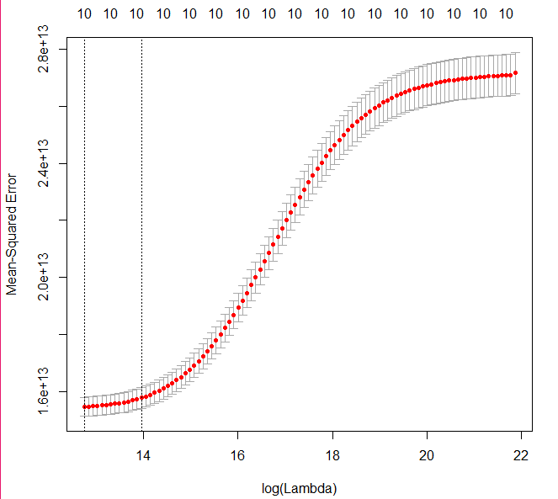
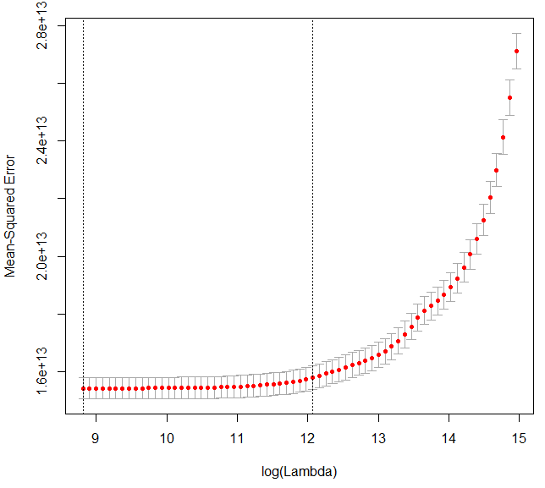
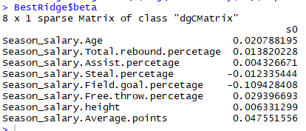
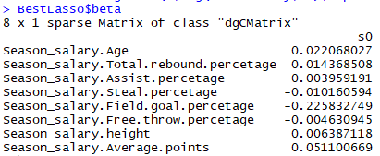
Salary Regression – Ridge & Lasso
Ridge
Lasso
Notes:
Compares to the ridge, lasso doesn’t drop any variables and the coefficient being slightly different.

Slide 13
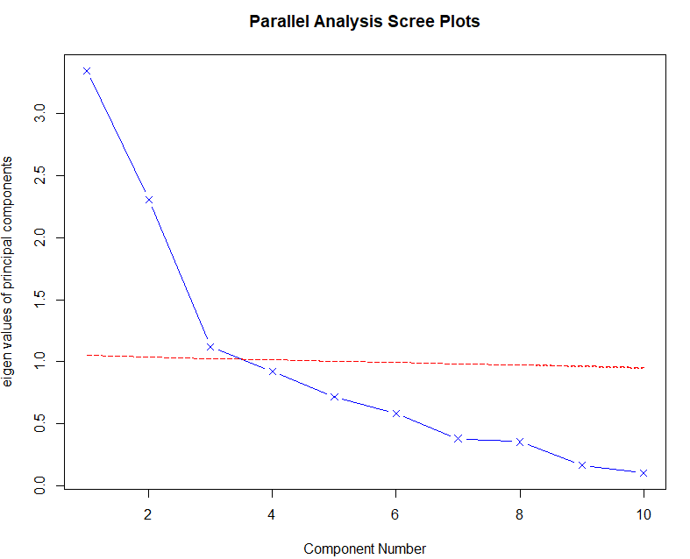
Salary Regression – Principle Components Analysis
N components = 3
Notes:
Reasonable to reject the linear hypothesis. Wonder if Multiple collinearity exists.

Slide 14
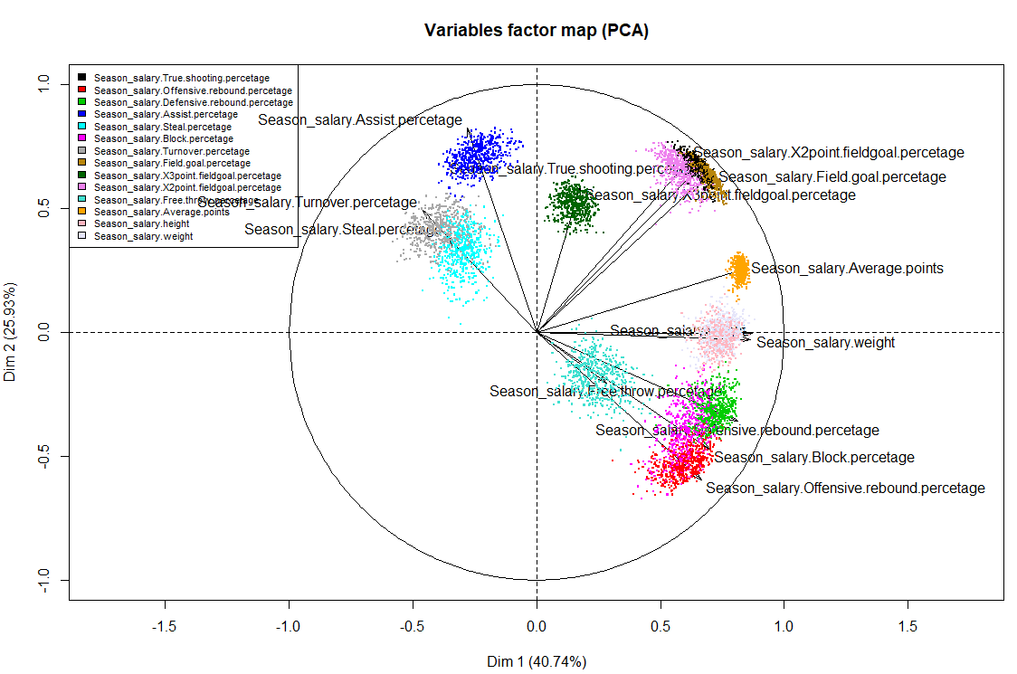
Salary Regression – Principle Components Analysis
3 principle components
using their contribution vectors to run the regression
Notes:
Dimension 1 explain 40$ of the data and dimension 2 explains 25% of the data

Slide 15
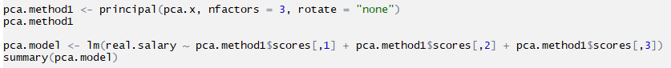
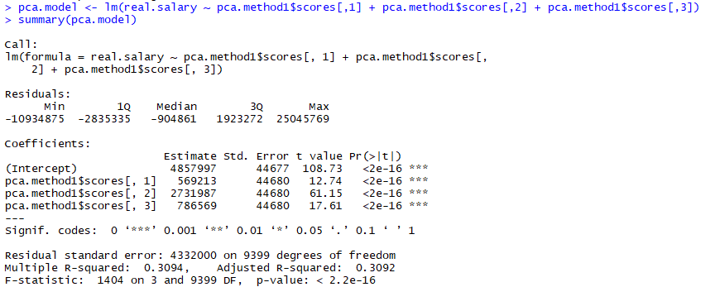
Salary Regression – Principle Components Analysis
Notes:
All the principle components are statistical significant

Slide 16
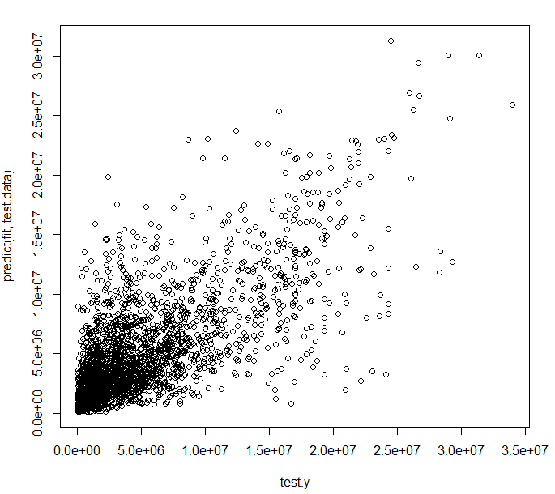
Salary Regression – Non-parametrics KNN model
Cross-validation – K=5
True value – Predictive Value
Notes:
Red line being the correct prediction

Slide 17
Salary Regression – Model Comparison
 | RMSE | Rsquared | MAE | RMSESD
lm | 3944625 | 0.382137 | 2831783 | 158356.8
Ridge | 3949925 | 0.425962 | 2835237 | 101798
Lasso | 3950078 | 0.426373 | 2824136 | 142177.3
PCA | 4400516 | 0.309213 | 3258618 | 174426.3
KNN | 3544878 | / | 2408443 | 140595

Slide 18
Hall of Fame Prediction
STEP1 : Hall of Fame Player Selection
STEP2: Create HoF identification -- 0-1 binomial
STEP3: Create training sample – former retired players
STEP4: Logistics regression to all variables – not about salary any more
STEP 5: Simple logistics to all variable won’t work
STEP 6: PCA introduced
STEP 7: Logistics regression to 6 principle components

Slide 19
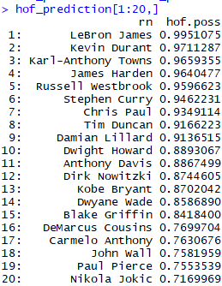
Hall of Fame Prediction
RESULTS : Hall of Fame Player Selection
STEP1 : Hall of Fame Player Selection
STEP2: Create HoF identification -- 0-1 binomial
STEP3: Create training sample – former retired players
STEP4: Logistics regression to all variables – not about salary any more
STEP 5: Simple logistics to all variable won’t work
STEP 6: PCA introduced
STEP 7: Logistics regression to 6 principle components

Slide 20
Conclusion
All players ’average points basically remains constant
Players are shoot more 3 points and less 2 points, and players are getting more free throws
NCAA traditional competitive teams are sending the most players to NBA
KNN model best fit with the salary
Hof prediction table
Future Work
Potential reason for residuals being large: high salary player got injury in a particular season
See how the Hall of Fame prediction possibility varies using different methods

Slide 21
NBA Player Stats Data Analysis
TTP 289 Project
Ye Chao

